Slide 1

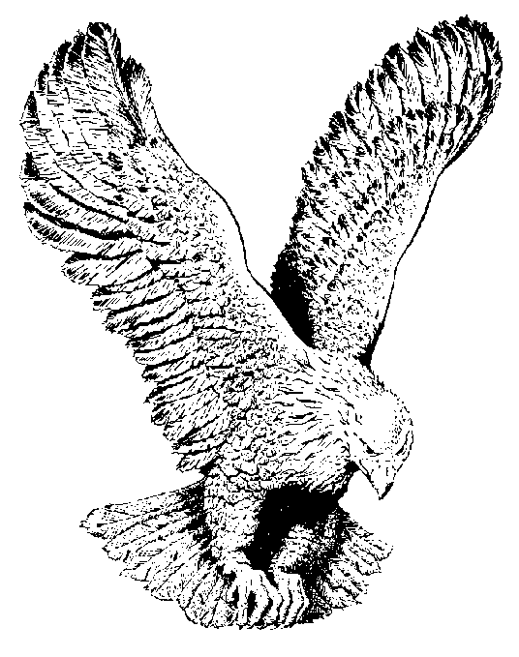
782 HEART OF THANKSGIVING
With my hands lifted up, and my mouth
filled with praise
With a heart of thanksgiving, I will bless
thee o Lord
I will bless thee o Lord, I will bless thee o
Lord
With a heart of thanksgiving, I will bless
thee o Lord.

